Slide 1
面向服务架构

Slide 2

上一讲回顾
软件架构——定义、目标、分类
  组织结构、控制结构、通信方式、交互协议、功能分配、物理分布、非功能性设计
  可靠性、安全性、可伸缩性、可定制化、可扩展性、可维护性、客户体验、市场时机
  逻辑架构、物理架构、系统架构
架构师？

Slide 3
上一讲回顾
服务、服务分类，面向服务的原则
  Loosely coupled software components that interact with one another dynamically via standard Internet technologies (Gartner).
  A piece of business logic accessible via the Internet using open standards (Microsoft).
  Services are self-contained, reusable software modules that are independent of applications and the computing platforms on which they run. Services have with well-defined interfaces and allow a 1:1 mapping between business tasks and the exact IT components needed to execute the task. (IBM)

Slide 4
第3章 SOA通用技术基础
Common Technical Fundaments for SOA

Slide 5
SOA基本层
SOA建立在现有中间件技术和分布计算概念的基础上，充分利用这些技术作为其实现的基础

Slide 6
分布式对象计算
分布式对象技术是在面向对象技术的基础上发展起来的，它要解决的主要问题是位于不同进程中的对象之间的调用问题。
分布式对象技术将传统的紧耦合的C/S应用分割成自管理的(self-managing)、可以通过网络调用的不同机器上的组件或对象
  SUN J2EE
    JavaTM 2 Platform, Enterprise Edition
  MS DCOM
    Distributed Component Object Model
  OMG CORBA
    Common Object Request Broker Architecture

Slide 7
分布式对象技术要解决的基本问题
分布对象技术要解决的问题
C++编译器完成连接
C++Main
Program
?
C++ Object
同一地址空间
a机
b机
就是支持访问异地对象
如何通信

Slide 8


通信机制的异质性
通信模式
  核心问题
  同步、异步（消息传递、发送/回调、发布/订阅、广播）
多种运行时特性需要考虑
  安全、容错、负载平衡、事务处理、日志、审计

Slide 9

通信模式
同步
发送者
接收者
同步调用
接收
阻塞等待
结果返回
响应

Slide 10
通信模式
异步：发送/回调
发送者
接收者
发出消息
接收
继续执行
接收消息
响应

Slide 11



通信模式
异步：发布/订阅
订阅者
发布者
订阅者
发布者
主题/Topic
订阅者

Slide 12

通信模式
异步：广播
接收者
发布消息
发布消息
发送者
接收者
发布消息
接收者

Slide 13
常用通信中间件框架
RPC（ Remote Procedure Call ）
  给那些分布在不同计算机上的应用提供互相通信的途径，是当今多数中间件的基础
分布式对象
  由ORB(Object Request Broker)支持
MOM（Message Oriented Middleware）
  基于消息队列，是大型企业通信基础结构的流行技术
消息代理
  MOM的扩展
同步
异步

Slide 14
RPC（Remote Procedure Call）
通过网络从远程计算机程序上请求服务，而不需要了解底层网络技术的协议
客户端调用客户端存根，存根把相关参数组装成一个或一组消息包，加入服务器端IP地址和执行此过程的进程ID号，形成一条消息；
客户端存根将消息发送至RPC运行时库；
客户端RPC运行时库将消息发送至传输层；
Call procedure
Execute procedure
Client application
Server application
1
7
Client stub
Server stub
2
6
RPC library
RPC library
3
5
Network protocol
Network protocol
4

Slide 15
RPC
消息由传输层传送至服务器端；
服务器端传输层将消息发送给服务器端RPC运行时库；
服务器端RPC运行时库将消息发送到Server stub上的一个子程序，由它处理消息；
Server stub的子程序拆解消息，解析出参数，并用本地调用方式执行过程。
Call procedure
Execute procedure
Client application
Server application
1
7
响应过程同理。
Client stub
Server stub
2
6
RPC library
RPC library
3
5
Network protocol
Network protocol
4

Slide 16
RPC的贡献
透明性
  允许程序可以象调用本地过程一样调用驻留在其他机器上的过程，调用者根本不知道被调用的过程是在另一台机器上运行的
提出客户端和服务器的概念
对分布式对象技术影响深远的概念有：
  接口定义语言IDL
  名称和目录服务
  动态绑定
  服务接口……

Slide 17
RPC程序开发过程
Step1 定义过程接口
Step2 编译过程接口的定义
  客户端存根(stub)
  服务器存根(stub/skeleton)
  客户端存根必须和服务器代码一起编译和连接
Step3 编写和编译实现代码
  服务器端：实现过程的代码
  客户端：应用逻辑代码

Slide 18
RPC的缺陷
受限于相同的RPC运行环境
需要了解一些网络细节以便定位服务器
客户端发出请求的同时，要求服务器必须是活动的
非面向对象编程

Slide 19
分布式对象
Call method
Execute method
Client application
Server application
Client proxies
Server skeletons
ORB
ORB
Network protocol
Network protocol
Create, locate, delete, invoke

Slide 20
分布式对象
思想
  “Interoperable Object References”
允许通过对象工厂和其他辅助对象，方便地远程创建、定位、删除和调用对象
提供了一个OO的分布式平台，理想是处理异构（硬、软件、厂商）
ORB支持位置透明，对客户端隐藏实现细节
实现：CORBA, COM/DCOM, RMI

Slide 21
CORBA发展史
Common Object Request Broker Architecture
OMG开发的标准, “to allow applications to communicate with one another no matter where they are located or who has designed them”
  1991, CORBA 1.1, IDL & API within an ORB
  1994, CORBA interoperability & IIOP (Internet Inter-ORB Protocol)
  1997, CORBA 2.1, Interoperability with COM
  1998, CORBA 2.2, Interoperability with Java
  2002, CORBA Component Model

Slide 22
CORBA目标
解决分布式计算环境中不同硬件、软件系统的互联，增强网络间软件的互操作性。
封装如下服务，简化分布式应用的开发：
  Object location
  Connection & memory mgmt.
  Parameter (de)marshaling
  Event & request demultiplexing
  Error handling & fault tolerance
  Object/server activation
  Concurrency
  Security
CORBA 定义了接口而不是具体实现！

Slide 23
CORBA应用程序结构
Object Request Broker: enables objects to transparently make and receive requests and responses in a distributed environment.
  The core of the reference model, “telephone exchange”
Object Services: a collection of services (interfaces and objects) that support basic functions for using and implementing objects.
  e.g. Naming, Life Cycle Service
Common Facilities: a collection of services that many applications may share, but which are not as fundamental as the Object Services
  e.g. e-mail facility
Application Objects: products of a single vendor on in-house development group that controls their interfaces.

Slide 24
CORBA中间件体系架构
Interface
Repository
IDL
Compiler
Implementation
Repository
Client
Object
IDL
Skeleton
Dynamic
Skeleton
Object
Adapter
Dynamic
Invocation
IDL
Stub
ORB
Interface
ORB Core
GIOP/IIOP
http://www.dre.vanderbilt.edu/~schmidt/TAO.html

Slide 25
ORB(Object Request Broker)
功能：提供一组服务逻辑
  定位远程对象，传输请求，等待结果返回并在结果返回时将它传给客户端
  实现对象位置透明
  与开发语言无关：接口翻译和语言绑定
优点
  客户端不必知道与服务器对象通信、激活或保存服务器对象的机制
  不必知道服务器对象的位置、编程语言、操作系统以及其他非对象接口的系统信息
Client
Object
Object Request Broker (ORB)

Slide 26
CORBA请求响应过程
Activate server
Implementation
Repository
1S
In args
Client
Object
Obj. ref.
Operation ()
3S
Out args + return value
Process Request
1C
Return Control to Client
4C
Locate target object
IDL
Stub
Return Request
IDL
Skeleton
Wait for request to complete
Send request to server
Activate Object’s Servant
3C
2C
4S
2S
ORB CORE

Slide 27
CORBA的缺陷
对象粒度小，通信负荷大
复杂，庞大，必须由精深技术专家使用
实现厂商平台的私有化造成CORBA所追求的互操作性难以实现
标准更新缓慢

Slide 28
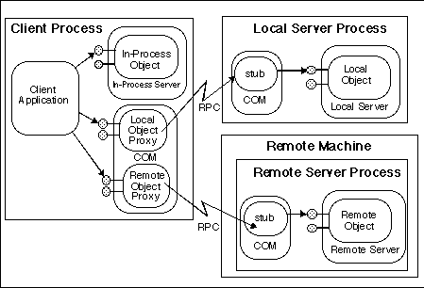
DCOM

Slide 29
DCOM
实现Microsoft平台上对象间跨进程通信，用网络协议来代替本地进程之间的通信
Client
Object
Proxy
COM
Run-time
COM
Run-time
Stub
Component
Security
provider
DCE RPC
Security
provider
DCE RPC
Protocol Stack
Protocol Stack
DCOM network protocol

Slide 30
微软是否后悔？
DCOM由单一开发者（微软）定义并控制，这大大限制了它的使用者的选择范围（比方说开发工具和风格）
DCOM缺乏众多的平台支持，这极大程度地制约了代码的可重用性和DCOM应用的可扩展性
本身的设计缺陷

Slide 31
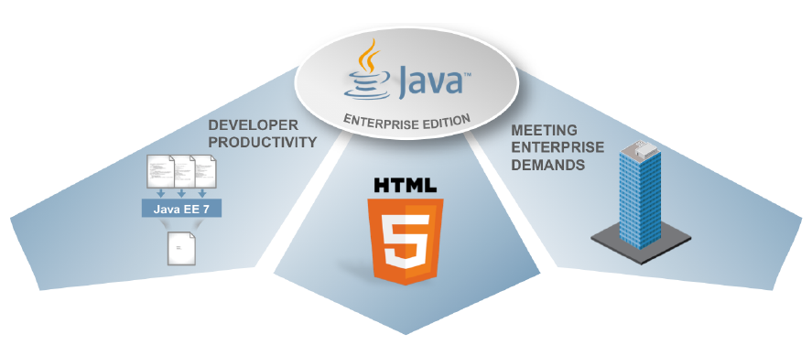
From J2EE to Java EE
发展史
  Oct. 1994, Public introduction of Java
  Jan. 1996, JDK 1.0 released
  Apr. 1997, EJB specification announced
  Dec. 1998, Java 2, SDK 1.2 released
  Jun. 1999, J2EE announced
  Dec. 1999, J2EE platform released
  Sep. 2001, J2EE 1.3 released
  Nov. 2003, J2EE 1.4 released
  2005, Java Platform, Enterprise Edition 5(Java EE 5)
  Now, Java EE8
https://en.wikipedia.org/wiki/Java_Platform,_Enterprise_Edition

Slide 32
Java EE应用架构
Client Side
Presentation
Server Side
Presentation
Server Side
Business Logic
Enterprise
Information
System
Browser
Web
Server
EJB
Container
Pure
HTML
JSP
EJB
Java
Applet
JSP
EJB
Desktop
Java
Application
Java
Servlet
EJB
Other Device
J2EE
platform
J2EE
platform
J2EE
Client

Slide 33
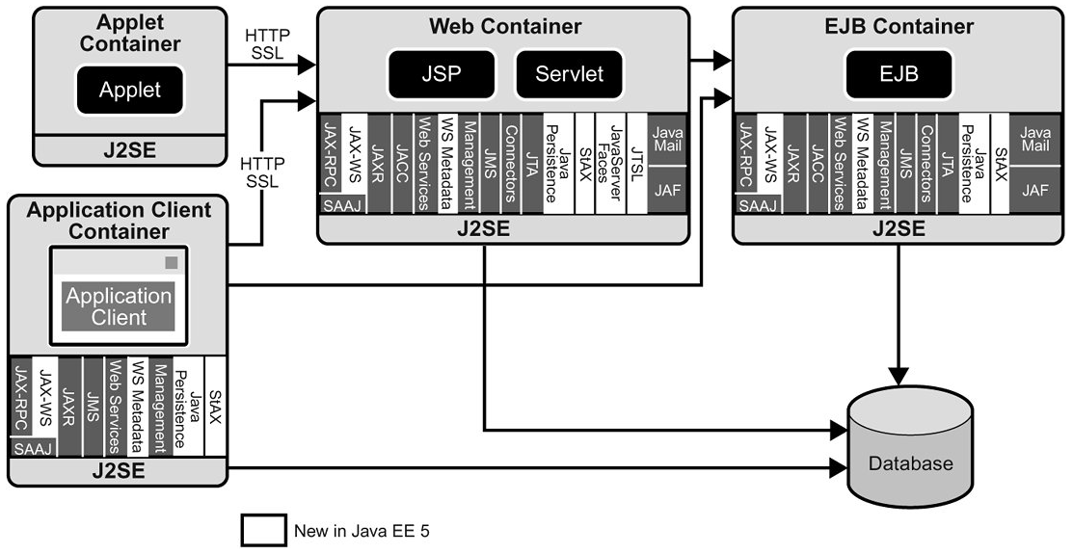
Java EE家族

Slide 34
Java远程方法调用
Java Remote Object Invocation (RMI)
Overview of RMI
RMI能让一个Java程序去调用网络中另一台计算机的Java对象的方法，那么调用的效果就像是在本机上调用一样
Local Machine (Client)
SampleServer remoteObject;
int s;
…
s = remoteObject.sum(1,2);
System.out.println(s);
Remote Machine (Server)
public int sum(int a,int b) {
return a + b;
}
1,2
3

Slide 35
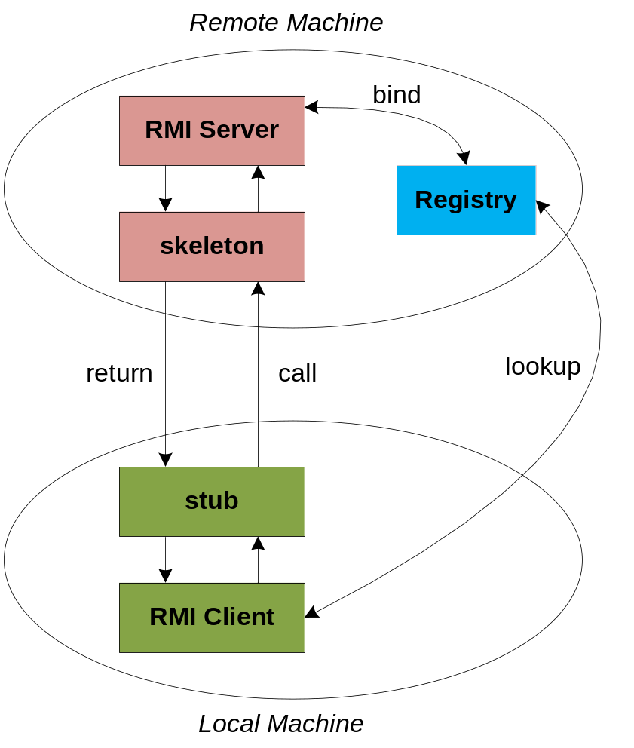
RMI Architecture
服务对象首先通过名字绑定到registry
The client 通过名字查找到服务对象，获得远程对象的引用
Stub串行化调用参数，发送给skeleton, skeleton 调用远程对象的方法，将结果串行化返回给stub.

Slide 36
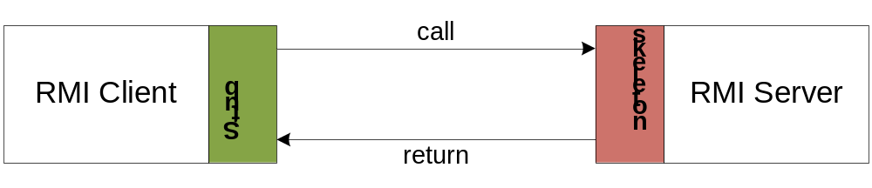
The Stub and Skeleton
客户stub的功能是把相关的参数组装成一个消息包或一组消息包。运行此方法的服务器地址和对象及方法的“标识符”、调用方法的参数都应包含在这条消息中。
将这条消息发送给对应的RMI运行时系统，该程序在转至指定的站点。
在接受此消息时，远程RMI运行时系统引用与被调用者对应的服务skeleton，并让它来处理这条消息。
服务器skeleton来反序列化有关参数，并用本地方法调用方式调用所需方法，然后把调用结果序列化，向调用者返回结果。
调用方RMI运行时系统棘手返回结果。调用者stub反序列化参数，然后，返回结果到调用方法。

Slide 37
Steps for Developing an RMI System
定义远程接口
开发实现远程接口的远程对象
开发客户端
编译java对象
生成客户端的stub和服务端的skeletons
启动RMI registry服务
启动远程对象
运行客户端

Slide 38
Step 1: Defining the Remote Interface
To create an RMI application, the first step is the defining of a remote interface between the client and server objects.
/* SampleServer.java */
import java.rmi.*;
//定义远程接口
public interface SampleServer extends Remote
{
public int sum(int a,int b) throws RemoteException;
}

Slide 39
Step 2: Develop the remote object and its interface
The server is a simple unicast remote server.
Create server by extending java.rmi.server.UnicastRemoteObject.
The server uses the RMISecurityManager to protect its resources while engaging in remote communication.
/* SampleServerImpl.java */
import java.rmi.*;
import java.rmi.server.*;
import java.rmi.registry.*;
public class SampleServerImpl extends UnicastRemoteObject
implements SampleServer
{
SampleServerImpl() throws RemoteException
{
super();
}

Slide 40
Step 2: Develop the remote object and its interface
Implement the remote methods
/* SampleServerImpl.java */
public int sum(int a,int b) throws RemoteException
{
return a + b;
}
}
The server must bind its name to the registry, the client will look up the server name.
Use java.rmi.Naming class to bind the server name to registry. In this example the name call “SAMPLE-SERVER”.
In the main method of your server object, the RMI security manager is created and installed.

Slide 41
Step 2: Develop the remote object and its interface
/* SampleServerImpl.java */
public static void main(String args[])
{
try
{
System.setSecurityManager(new RMISecurityManager());
//set the security manager
//create a local instance of the object
SampleServerImpl Server = new SampleServerImpl();
//put the local instance in the registry
Naming.rebind("SAMPLE-SERVER" , Server);
System.out.println("Server waiting.....");
}
catch (java.net.MalformedURLException me) {
System.out.println("Malformed URL: " + me.toString()); }
catch (RemoteException re) {
System.out.println("Remote exception: " + re.toString()); }
}

Slide 42
Step 3: Develop the client program
In order for the client object to invoke methods on the server, it must first look up the name of server in the registry. You use the java.rmi.Naming class to lookup the server name.
The server name is specified as URL in the from ( rmi://host:port/name )
Default RMI port is 1099.
The name specified in the URL must exactly match the name that the server has bound to the registry. In this example, the name is “SAMPLE-SERVER”
The remote method invocation is programmed using the remote interface name (remoteObject) as prefix and the remote method name (sum) as suffix.

Slide 43
Step 3: Develop the client program
import java.rmi.*;
import java.rmi.server.*;
public class SampleClient
{
public static void main(String[] args)
{
// set the security manager for the client
System.setSecurityManager(new RMISecurityManager());
//get the remote object from the registry
try
{
System.out.println("Security Manager loaded");
String url = "//localhost/SAMPLE-SERVER";
SampleServer remoteObject = (SampleServer)Naming.lookup(url);
System.out.println("Got remote object");
System.out.println(" 1 + 2 = " + remoteObject.sum(1,2) );
}
catch (RemoteException exc) {
System.out.println("Error in lookup: " + exc.toString()); }
catch (java.net.MalformedURLException exc) {
System.out.println("Malformed URL: " + exc.toString()); }
catch (java.rmi.NotBoundException exc) {
System.out.println("NotBound: " + exc.toString());
}
}
}

Slide 44
Step 4 & 5: Compile the Java source files & Generate the client stubs and server skeletons
Assume the program compile and executing at elpis on ~/rmi
Once the interface is completed, you need to generate stubs and skeleton code. The RMI system provides an RMI compiler (rmic) that takes your generated interface class and procedures stub code on its self.
    elpis:~/rmi> set CLASSPATH=”~/rmi”
    elpis:~/rmi> javac SampleServer.java
    elpis:~/rmi> javac SampleServerImpl.java
    elpis:~/rmi> rmic SampleServerImpl
    elpis:~/rmi> javac SampleClient.java

Slide 45
Step 6: Start the RMI registry
The RMI applications need install to Registry. And the Registry must start manual by call rmiregisty.
The rmiregistry us uses port 1099 by default. You can also bind rmiregistry to a different port by indicating the new port number as : rmiregistry <new port>
elpis:~/rmi> rmiregistry
Remark: On Windows, you have to type in from the command line:
> start rmiregistry

Slide 46
Steps 7 & 8: Start the remote server objects & Run the client
Once the Registry is started, the server can be started and will be able to store itself in the Registry.
Because of the grained security model in Java 2.0, you must setup a security policy for RMI by set java.security.policy to the file policy.all
elpis:~/rmi> java –Djava.security.policy=policy.all SampleServerImpl
elpis:~/rmi> java –Djava.security.policy=policy.all SampleClient

Slide 47
Java Policy File
In Java 2, the java application must first obtain information regarding its privileges. It can obtain the security policy through a policy file. In above example, we allow Java code to have all permissions, the contains of the policy file policy.all is:
grant {
permission java.security.AllPermission;
};
Now, we given an example for assigning resource permissions:
grant {
permission java.io.filePermission “/tmp/*”, “read”, “write”;
permission java.net.SocketPermission “somehost.somedomain.com:999”,”connect”;
permission java.net.SocketPermission “*:1024-65535”,”connect,request”;
permission java.net.SocketPermission “*:80”,”connect”;
};

Slide 48
作业
使用 RPC 编程（socket、RPC、RMI、WebSocket、GRPC、Thrift…，至少一种方式）实现一个远程对象的调用过程。客户端程序发送调用消息（自定义消息的格式）到服务器端，服务器端接收的调用消息，调用本地对象Hello，并将结果返回给调用方，并且显示。
  Public class Hello{
  public String hello(String greeting){
  return greetring +“from server” ;
  }
  }
  编程实现可以是Java，C#或者C++

Slide 49
参考工具：
C++ Communication Environment (ACE)
  http://www.dre.vanderbilt.edu/~schmidt/ACE-overview.html
JAVA RMI Doc
  https://docs.oracle.com/javase/tutorial/rmi/
WebSocket Doc
  http://www.w3.org/TR/2011/WD-websockets-20110419/
  http://www.oracle.com/webfolder/technetwork/tutorials/obe/java/HomeWebsocket/WebsocketHome.html
GRPC
  https://grpc.io/
Thrift
  http://thrift.apache.org/

Slide 50
谢谢
The End

